Slide 2
The Importance of a Biblical Worldview
Navigating through the Cultures’ Messages

Slide 3
Parenting in a Tsunami
We are parenting against views, ideologies, and philosophies that are coming from a culture that is not basing truth on biblical truth
As parents, we must constantly renew our minds in the truth of God’s word

Slide 4
Biblical Worldview
A biblical worldview applies God’s truth, as revealed in the bible, in order to interpret the culture and address every area of life including questions regarding:
God
Man
Destiny
Purpose
Morality
Evil

Slide 5
Reality
God created
Sin destroys
Savior delivers
Life is temporary
Eternal life - final destination

Slide 6
The battle
Colossians 2:8
See to it that no one takes you captive by philosophy and empty deceit, according to human tradition, according to the elemental spirits of the world, and not according to Christ.

Slide 7
Filter the Culture
As parents, we must be able to filter the worldviews in the culture through God’s truth
As parents, we must have a consistent, intentional, seeking after God’s truth

Slide 8
The battle
Romans 12:2
Do not be conformed to this world, but be transformed by the renewal of your mind, that by testing you may discern what is the will of God, what is good and acceptable and perfect.

Slide 9
Priority
Mark 12:28–31
The Great Commandment
[28] And one of the scribes came up and heard them disputing with one another, and seeing that he answered them well, asked him, “Which commandment is the most important of all?” [29] Jesus answered, “The most important is, ‘Hear, O Israel: The Lord our God, the Lord is one. [30] And you shall love the Lord your God with all your heart and with all your soul and with all your mind and with all your strength.’ [31] The second is this: ‘You shall love your neighbor as yourself.’ There is no other commandment greater than these.” (ESV)

Slide 10
Culture’s View
Truth is relative - feelings rule
There is no God - we are our own gods
Man is innately good - nurture & environment is to blame
Religion is harmful - causes division
Now is all there is - no afterlife

Slide 11
The Balance
As parents we need to not isolate our children from the culture but rather equip them to function in the culture driven by God’s truth
John 17:15–17
I do not ask that you take them out of the world, but that you keep them from the evil one. They are not of the world, just as I am not of the world. Sanctify them in the truth; your word is truth.

Slide 12
Proverbs 30:5
Every word of God proves true; he is a shield to those who take refuge in him. (ESV)

Slide 13
Importance of Parents
In Counseling

Slide 14
C. H. Spurgeon
“I heard of a man who said that he did not like to prejudice
his boy, so he would not say anything to him about
Religion. The devil, however, was quite willing to prejudice
the lad, so very early in life he learned to swear, although
his father had a foolish and wicked objection to teaching him
to pray. If ever you feel it incumbent upon you not to
prejudice a piece of ground by sowing good seed on it, you
may rest assured that the weeds will not imitate your
impartiality. Where the plow does not go and the seed is
not sown, the weeds are sure to multiply. And if children are
left untrained, all sorts of evil will spring up in their hearts and lives.”

Slide 15
Examples of Families in Scripture
Good Examples
Bad Examples

Slide 16
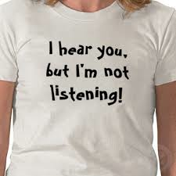
Why Do Families Struggle with This?
Pace of Life, it takes time
Cultural Priorities
Feeling Inadequate
We value compliance, over dialog (or relationship)
We look for quick fixes rather than long-term bridge building
We serve the
wrong agenda

Slide 17
Parents are Experts at Knowing Their Own Family
They just need help
They may be apart of the problem, but the always need to be part of the solution

Slide 18
Children interpret life and experiences, whether or not we talk to them about it. Often we avoid discussing what we don’t want to deal with, thinking that children will not think about it. The problem is that children already are thinking, interpreting, and drawing conclusions about their life – and they are doing it without any loving guidance or a redemptive worldview.

Slide 19
Deuteronomy 6:6-9
“And these words, which I am commanding you today, shall be on your heart; and you shall teach them diligently to your sons and shall talk of them when you sit in your house and when you walk by the way and when you lie down and when you rise up. And you shall bind them as a sign on your hand and they shall be frontals on your forehead. And you shall write them on the doorposts or your house and on your gates….”

Slide 20
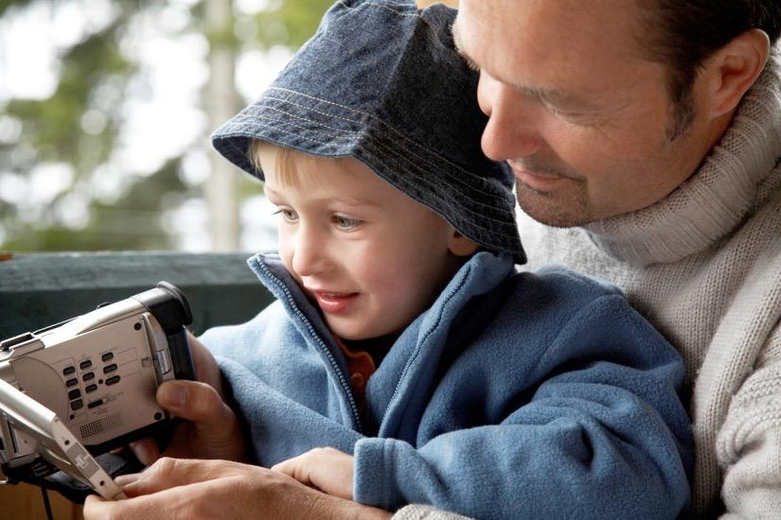
Be Proactive, not Reactive
It is far better to proactively shape a child’s understanding of a subject, than to debunk an inaccurate view.

Slide 21
Counseling Children is like a Puzzle

Slide 22
Can Children Handle the Current?

Slide 23
Parental Influence vs. Peer Influence
Peer Influence
Lacks life experience
Limited in resources and help
Lacks insight & wisdom
Assumes autonomy & maturity
Sees adults as inadequate or insignificant
Is often self-serving
“My Truth”
Parental/ Adult Influence
Looks out for the child
Assumes greater life experience and wisdom
Usually does not have anything to gain/ not self-serving
Understands we all need help
Values building relat.
Points to the Lord for the source of truth

Slide 24
Negative Peer Influence
A false sense of maturity/ confidence (arrogance) in their self-knowledge
An inability to occupy themselves or be alone
Tolerance for bad behavior and inappropriate peer demands
Intolerance of wisdom- Mocking what is good/ wholesome
Turning a blind eye to immoral/ risky behavior
Disparaging authority and adult values
A lack of humility and teach ability

Slide 25
Parental Authority
It builds respect and cooperation.
It creates an atmosphere of deference and admiration.
It provides security and connection with children.
It encourages a child’s healthy dependence on parents for spiritual and emotional nurture.
It models a reliance on wise counsel, especially from the Lord.
It models a proper respect for leadership and governance.

Slide 26
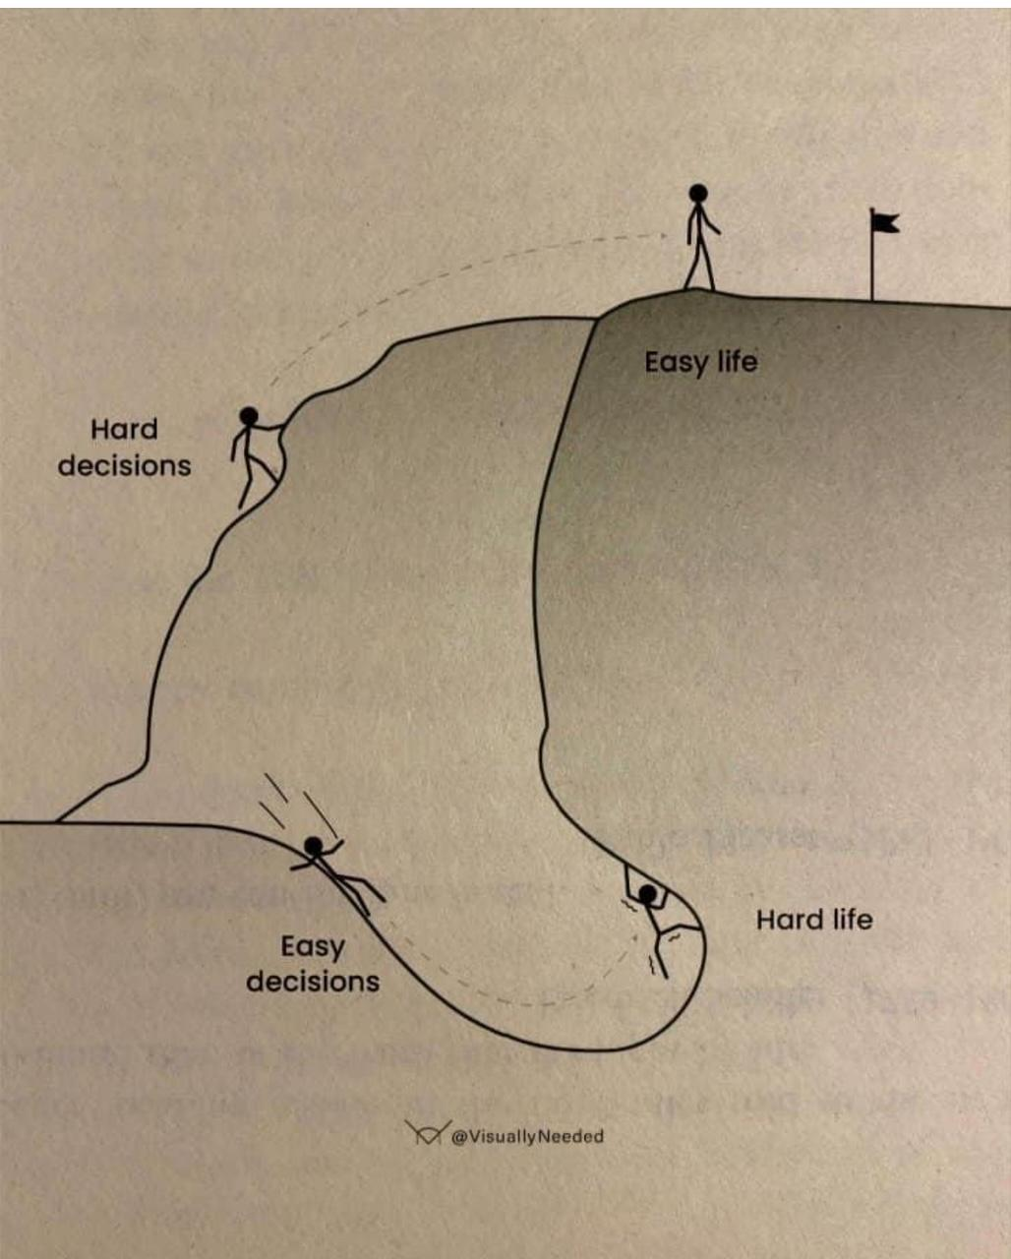
Too often the easy road is taken in parenting.
We want easy solutions or quick resolution, rather than willing to take the harder path that leads to long-term change.

Slide 27
Rules
Relationship
Without
=
Rebellion
“Trust, and not submission, defines obedience.”
A Gathering of Days, Joan W. Blos, 1979

Slide 28
Don’t Spare Discipline and Raise a Fool
“If parents carry (discipline) lovingly towards their children,
mixing their mercies with loving rebukes, and their loving rebukes with fatherly and motherly compassions, they are
more likely to save their children than being churlish and severe towards them.” John Bunyan

Slide 29
Help Parents to:
Identify what they already know about their children
Pursue their kids
Go against what is cultural, even if hey are criticized
Press into what is hard: Forced Family Fun
Look for opportunities to talk and ask questions
Be willing to bring up the hard topics before they do – demonstrate you are not inadequate or indifferent
Know what resources/ help is out there
Affirm love for them.

Slide 30
Philosophy of Counseling
Children, Teens & Families

Slide 31
Introduction
There are some unique challenges to counseling kids/teens
Developmental factors
Parent involvement
Degrees of confidentiality

Slide 32
Parents are Primary Disciplers
•We want to give parents tools to succeed
•When relationships are strained help both sides listen
•If we don’t change the system we don’t change the problem
•We must be careful not to be triangulated

Slide 33
Developmental Factors
•The younger the child the more activities help them to process
•Younger children will do best with heavy caregiver involvement
•Kids are smarter than you think…be careful what you say and how you say it
•In younger years the tasks are related to communication, control/mastery of skills, attachment, physical coordination, cognitive reasoning, etc.
•Middle school years peer relationships become a focus, responsibility and freedom, beginning to test authority and think independently

Slide 34
Developmental Factors
In later teens the tasks of identity, autonomy and affiliation become central
When you talk about a child in the room don’t act like they are not in the room!
Help kids express feelings to their parents but also help them to be honoring
Help parents to express feeling to their kids but help them to be caring
Teens usually want to meet independent from parents
Parents still need to be discretely involved even if a teen wants autonomy
How you handle disclosure of information is important to build trust
The way you counsel with a teen is going to be different than with adults

Slide 35
The Target is Heart Change (Prv 4:23)
•Issues of depression and anxiety may present differently
•With both kids and parents the target is the heart
•A heart of anger or foolishness may be masking fear or despair
•Addressing symptoms or behavior will not lead to lasting change
•The Gospel may not be fully grasped even if they are claiming Christ
•Helping them repent, lament, or forgive can be freeing

Slide 36
Expect More Case Management
•You are likely going to be working with both parents and the child
•You should consider others who can help as you develop a care team
•You will want to be holistic and multidisciplinary in approach
•Medical, educational, social, and church support may be needed
•It takes more time and a collaborative spirit

Slide 37
Parent Coach and Consultant
•You will not only counsel the child, you will coach parents
•Parents needing individual counsel better off with another counselor
•Encourage parents on better ways to reach their kids
•You will find yourself consulting with teachers, other caregivers

Slide 38
The Advantage of a Mentor/Advocate
•A big brother/big sister type person in the mix is a huge help
•At times I have had a mentoring couple for the parent and the child
•Advocates help create a motivation to close the gap of understanding
•You will need to be captain of the care team
•Leverage the relational capital of the advocate(s) in the sessions

Slide 39
Be Creative
•Sitting across from a child with only words in your arsenal may be hard
•Use humor to disarm and gain passport
•Pray for them out loud and have them pray if they are comfortable
•Use activities to set at ease and engage
•Bring in favorite food or drinks to be more relational
•Go for a walk or play outside to break up time/hard counseling topics
•Use toys, art, music depending on age
•Consider equine therapy, rope courses, shooting baskets…
•Kids listen better and speak more if multiple ways to connect

Slide 40
Q & A

Slide 41
Biblical Rationale for Expressive Therapies
Redeeming Play

Slide 42
“The purposes of a man’s heart are
deep waters,
but man of understanding draws
them out.”
Proverbs 20:5
42

Slide 43
Seeing Children as Multi-faceted
Saint – Child of God
Temperament
Strengths/ Weaknesses
Giftedness
Aptitudes/
Disabilities
Sinner
Sufferer

Slide 44
The Developmental Stages

Slide 45
The Individual
Image Bearer
Redeemed in Christ
Creational
(Strengths/ Weakness,
Abilities/ limitations)
Situational
(personal history
Experiences,
Suffering, blessings)
Fallen Nature

Slide 46
Knowing Children
Character
Temperament
Patience
Independent/ dependent
Honesty
Extroverted/introverted
Courage
Loud/ quiet
Innate Qualities
Developed traits
Integrity
Leader/ follower
Kindness
Aggressive/ passive
Sensitivity, empathy, attentiveness, aggressiveness
memory problems, organization

Slide 47
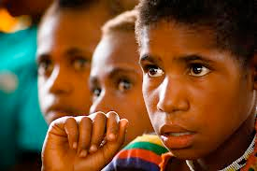
“The skill is to listen, the gift is to hear.”
47

Slide 48
Definition of Play:
“Play therapy is the systematic use of a theoretical model to
establish an interpersonal process wherein trained play
therapists use the therapeutic powers of play to help clients
prevent or resolve psychosocial difficulties and achieve
optimal growth and development.” Association of Play Therapy
User friendly
Decreases resistance
Natural and instinctive
Expressive
Projective
Uses the child’s preferred way of communication
48

Slide 49
The Umbrella of Expressive Therapies
Play Therapy
Art Therapy
Drama Therapy
Animal-Assisted Therapy
Dance Therapy
Music Therapy
Bibliotherapy
Sandtray Therapy

Slide 50
Wisdom in Approach
God as Father & Wise Counselor
Relational, respectful,
draws out inner world/ motivation,
Listens, reflects, walks along-side
Informative, Re-interprets reality,
Encourages, speaks into/ addresses,
rebukes when needed
Danger Zone
Child-centered
Directive/ didactic
Core = Sufferer
Resources are found within themselves
Non-intervening, Rogerian, non-directive
Core= Personal Responsibility
External Intervention
CBT/ Family Systems/ Reality Therapy

Slide 51
Evaluate
1. How does this child see themselves and the
world around them?
(Becoming an expert at know the child)
2. How should they be viewing life?
(Knowing Scripture)
3. How do I help them get there?
(Speaking creatively and redemptively into their world)
51

Slide 52
Luke 6:43-45
For no good tree bears bad fruit, nor again
does a bad tree bear good fruit, ⁴⁴ for each
tree is known by its own fruit.
For figs are not gathered from thornbushes, nor are grapes picked from a bramble bush.
⁴⁵ The good person out of the good treasure of his heart produces good, and the evil
person out of his evil treasure produces evil,
for out of the abundance of the heart his
mouth speaks.

Slide 53
Child’s Relational Assessment
Put all the people you are closest to in the 1st box
Who do you go to
when you
need help? (Circle)
People you are slightly less
close to in the 3rd box
Who do you spend
the most time with?
(Underline)
Continue with
adding people
you feel are a
part of your
life, but not as
close to.
Name
Of all the people
You know, who
do you think likes
you best? (star)
Who do you struggle with most? (box)
People who are a big part of your life, but you do not get along with
Where would you
place God?

Slide 54
Child’s Relational Assessment
God
Who do you go to
when you
need help? (Circle)
Grandpa Joe
Dee
Dee
(cousin)
Aunt Lee
Ashley
Who do you spend
the most time with?
(Underline)
Mom
Ashley
Rufus
Lucky
Joy
Of all the people
You know, who
do you think likes
you best? (star)
Deb
Dad
Grandma
Grandpa
Who do you struggle with most? (box)
Kelly
Brian
Mark (brother)
Where would you
place God?

Slide 55
Sand Trays
Sand trays help build the world of the counselee
through symbols or figures. The figures give you
a language you don’t need words for – it
expresses life. Often, it is a tool to help those who
are “stuck”. The sand tray is able to continue to
take form and help a counselee find
resolve/ solutions.
55

Slide 58
Therapy Animals
Cherry & Spud

Slide 59
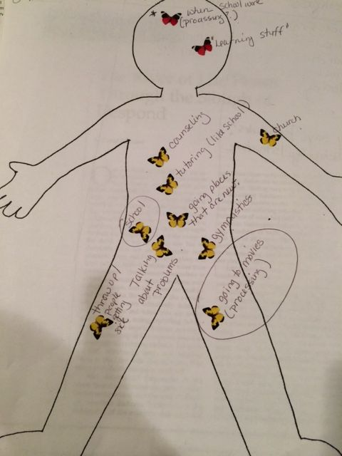

Slide 60
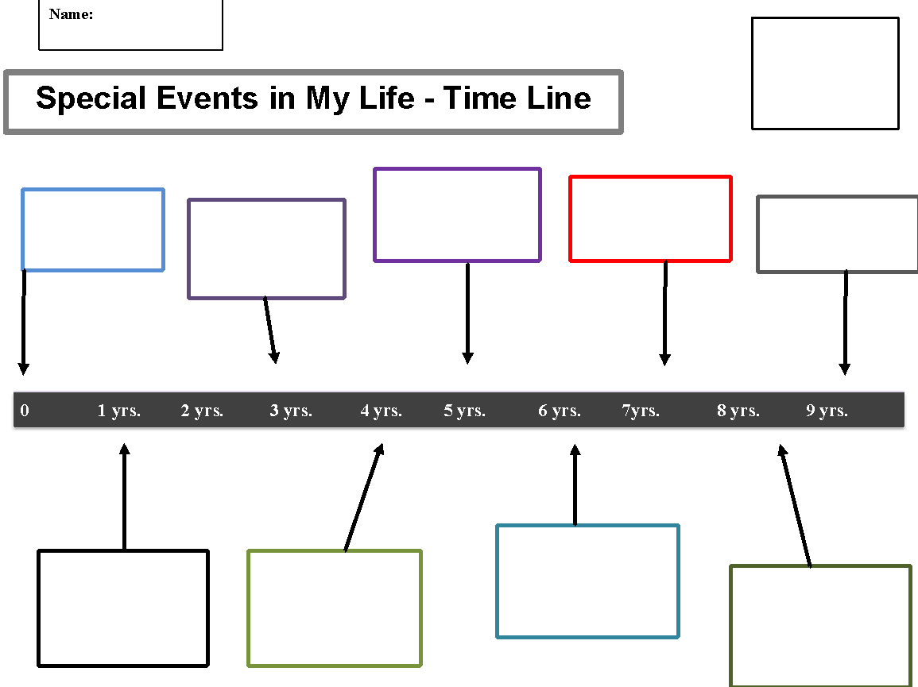
Time lines and Maps

Slide 61
Be intentional about the direction you are going with a child.
Don’t just fill time, let the child lead, or become aimless.
children sense this and will begin feeling the same way. You
don’t want children to think counseling “doesn’t work”.

Slide 62
Deuteronomy 6:6-9
“And these words, which I am commanding you today, shall be on your heart; and you shall teach them diligently to your sons and shall talk of them when you sit in your house and when you walk by the way and when you lie down and when you rise up. And you shall bind them as a sign on your hand and they shall be frontals on your forehead. And you shall write them on the doorposts or your house and on your gates….”

Slide 63
Contemporary Issues
In Counseling Children

Slide 64
Risk
Root
Relationship
Resources
Urgent 1st Responses?
What resources need to be involved?
What are the questions we need to be asking?
How does it manifest?
What are the root causes?
What often informs this struggle?
What is motivating the behavior?
What is at the heart of this?
How does this impact their relationships?
What relationships help/ must be involved?
What supports should you put in place?
What resources are there for this struggle?
For the counselor?
For the family?

Slide 66
Anxiety (Spectrum of separation anxiety, panic, OCD)
Risk
Risk
Root
Root
Relationship
Relationship
Resources
Resources
Avoidance / Isolation
Avoidance / Isolation
Biological
Biological
Parents
Parents
Mentor
Mentor
Over-react or under-react
Over-react or under-react
Temperamental
Temperamental
Siblings
Siblings
Team Approach
Team Approach
Secondary Gains
Secondary Gains
Situational
Situational
Friends
Friends
Consistency of Response
Consistency of Response
Self-soothing behaviors
Self-soothing behaviors
Where does safety/ comfort come from?
Where does safety/ comfort come from?
Teachers
Teachers
Practical Interventions
Practical Interventions
Where do we go with our fear?
Where do we go with our fear?
View of God
View of God
Biblical Expressive Activities
Missing struggle due to
behavior
Biblical Expressive Activities
Missing struggle due to
behavior
Biblical Triaging
Biblical Triaging
What do they fear most? Why?
What do they fear most? Why?
View of self
View of self
Resource List (see attachment)
What does Scripture have to say?
Resource List (see attachment)
What does Scripture have to say?
Collaborative help
Collaborative help
What are they believing?
What are they believing?

Slide 67
Most Common Worries of Kids
School performance
Appearance
Social acceptance
Death of a Parent
Friends
Global - hunger, war, etc.
Ages 7-15

Slide 68
An Anxiety Epidemic
#1 Disorder in US - and many other countries (10-17 countries listed it as the #1)
25% of population has had it or will have it
Confusing world - “Safe, but not safe” airports, schools with armed officers, bomb threats, etc.
Paul Foxman, Ph.D. The Worried Child

Slide 69
Three Ingredients in Anxiety
Biological Sensitivity- 20% of infants are born more sensitive to external/internal factors
Personality Traits- responsible, perfectionistic, difficulty relaxing, worry, likes to please, avoids conflict, prefers structure, low assertiveness
Stress Overload – stress often creates/ fosters anxiety (lack of sleep, proper nutrition, etc.)
Paul Foxman, Ph.D.

Slide 70
When Should I be Concerned?
3 Factors:
Frequency
Intensity
Duration
Measured by the degree to which it impedes
daily abilities

Slide 71
When Your child is drowning, don't try to teach them to swim
Notes:
When they are drowning in their emotions, don't try to teach them to swim.
Rescue them, until they are at a safe/ calm place to learn to “swim.”

Slide 72
Practical Approaches
Time Management
Reasonable Goals
Outdoor Recreation
Structure and Rhythms
Limit Media
Talking with others
Relaxation
Stress Management
Addressing fears rather than stuffing
Diet and nutrition

Slide 73
How to Deliver the Message
Model a positive expression of emotion
Be proactive, rather than reactive
Promote Openness – “We can talk about anything”
Consider what is developmentally helpful
Cultivate a godly, appropriate self-image
Feel Free to use good resources to help you
Point them to their need for Christ

Slide 74
Behavioral Issues (bullying, ODD, anger, etc.)
Risk
Root
Relationship
Resources
Alienation
Rule out biological
Parents
Mentor
Type casted
Temperamental
Siblings
Natural Consequences
Harm to others
Situational
Peers
Consistent responses
Teachers
Parent coaching
Authorities
School’s plan
God
Youth Leaders

Slide 75
Contemporary Issues
In Counseling Teens

Slide 76
Self-destructive (self-harm, suicide, escapism)
Risk
Root
Relationship
Resources
l Infection
Seeking attention
School partnership
Safety plan
Permanent scarring
Temporary relief
Loneliness
Open space to talk
Becoming addictive
Numbing pain of trauma
Safe person for accountability
Removing sharp objects
Isolation
Entitlement
Dishonesty
Resource list
Suicidal ideation
Need to punish self
Isolation
Reduce social media use
Need to be in control
Stress management
Escapism
Depression
Guilt
Shame
Wrong view of body

Slide 77
Social Media & Technology
Technology isn't the problem...

Slide 78
Technology can be our best friend, and technology can also be the biggest party pooper of our lives. It interrupts our own story, interrupts our ability to have a thought or a daydream, to imagine something wonderful, because we're too busy bridging the walk from the cafeteria back to the office on the cell phone.
(Steven Spielberg)

Slide 79
The Attraction
Instant gratification
Total access
Isolation
Acceptance
Escapism

Slide 80
The Danger
Addiction
Isolation
False sense of reality
Narcissism
Anxiety
Exploitation
Depression

Slide 81
The Heart
The beliefs of our teens will determine their behaviors
Social media is a fire hydrant of information containing propositional truths
The heart will be persuaded by the loudest voices speaking

Slide 82
The Heart
Matthew 15:19
For out of the heart come evil thoughts, murder, adultery, sexual immorality, theft, false witness, slander.

Slide 83
The Heart
Proverbs 4:23
Keep your heart with all vigilance,
for from it flow the springs of life.

Slide 84
Counsel
God has hardwired us to be in person-to-person community relationships
Parents need to cultivate interpersonal relationships with their teens
Parents need to enter the world of their teens not as a judge but rather a participant

Slide 85
The Heart
"Parent with your presence"
(Dr. Kathy Koch: Screens and Teens: Connecting with Our Kids in a Wireless World)

Slide 86
Addictions (of various forms drugs, alcohol, porn, gaming, social media)
Risk
Root
Relationship
Resources
Alienation
Shame
Accountability
Resource list
Financial
Guilt
Dysfunction
Mentors
Physical harm
Pleasure
Deception
Groups
Psychological harm
Self-medicating
Parents
Accountability
Selfishness
Authorities
Boundaries
Idolatry
Pastors

Slide 87
Case Studies
10 year old child and parents

Slide 88
Presenting Problems
Billy was referred to you after his Christian school principal met with his parents about some “concerning behavior” at school
Potentially bullied by peers
• Anger outbursts at school
• Refused to do school work
• Parents are concerned and believe there is more to the story

Slide 89
Initial Assessment
•Parents do most of the talking, especially mom
•Billy is holding back at first
•When alone with Billy he is much more verbal
•He admits to being bullied on social media

Slide 90
Further Assessment
Sent forms to parents and teachers
• Learned he has some gender identity issues
• There is some suicidal ideation
• Teacher encouraged pronouns and points Billy to explore
• Parents unaware of school and internet influence

Slide 91
Focus of Counsel
Risk? Self harm? Isolation? Gender confusion? Social Media?
Root? Identity issues? Father void? Rejection? Need for acceptance?…
Relationships? Parents, girlfriend, teachers?
Resources? What Scripture, what community resources, school, church? Books, studies?

Slide 92
Group Discussion
• What do you need to share with parents?
• How do you coach parents?
• How do you address the gender identity issues?
• How do you help the school and how do you share concerns there?
• How do you anticipate Billy’s reaction as you begin to coach parents on more guidelines, engagement, and taking the lead on discipleship/discipline with Billy going forward?

Slide 93
Case Studies
16 year old teen and parents

Slide 94
Presenting Problems
Susie was referred to you after her parents had been talking to their small group leaders.
•Christian home
•Sneaking out of the house at night
•Suspect sexual activity
•Parents are concerned with growing anxiety, rebellion, and suspected lying
•Susie did not chose to be in counseling

Slide 95
Initial Assessment
•Parents shared openly but anxious
•Susie seemed detached and uncomfortable
•Life story provided more thorough background information

Slide 96
Further Assessment
Sent forms to parents and for Susie to fill out
•Learned she had a history of self-consciousness
•Mild defect as child brought up some social anxiety
•Connected at youth group but not open
•Recently more withdrawn, moody and sensitive

Slide 97
Focus of Counsel
•Risk? No ownership? Self condemnation? STD’s?
•Root? Autonomy and affiliation issues? Father void? Rejection? Need for affirmation?…
•Relationships? Parents, youth group, boyfriend, Christ?
•Resources? What Scripture, what community resources, school, church? Books, studies?

Slide 98
Group Discussion
One way to address Susie would be the C.A.R.E. steps (connect, assess, respond, encourage).
•How would you connect and build trust?
•As far as confidentiality what do you need to share with parents?
•What is important to get a accurate assessment of her life story?
•What are some way you could respond that would help her gain trust and hope?
•How do you encourage deeper dependence on Christ and community?

Slide 99
Resources
1. Garret Higbee Garrett Higbee: garret@soulcareconsulting.com President, Soul Care Consulting soulcareconsulting.com
2. Pastor Ron Jones: counseling286@gmail.com
3. Julie Lowe: julieslowe@gmail.com
www.JulieLowe.org
4. The Annual Guide to Biblical Counseling Resources: 2024
https://partners.biblicalcc.org/purchase-the-annual-guide/

