Slide 1
“When Sorrows Like Sea Billows Roll.”
Rachael Rosser- Schulte, LPCS

Slide 2

“God will take us where we do not want to go in order to produce in us what we could not achieve on our own.” Tripp, Paul David
“It is better to go to a house of mourning than to go to a house of feasting, for death is the destiny of everyone; the living should take this to heart.” Ecclesiastes 7:2

Slide 3
“Grief is not a series of stages that you complete in some stereotypical consecutive order. Grief is a very individual process—a personal journey that we take with our personal suffering Savior.” Kellemen, Bob. Grief: Walking with Jesus
.
Elizabeth Kubler-Ross, Secular Model of Grief
• Denial: This is the shock reaction. “It can’t be true.” “No, not me.” We refuse to believe what happened.
• Anger: Resentment grows. “Why me?” “Why my child?” “This isn’t fair!” We direct blame toward God, others, and ourselves. We feel agitated, irritated, moody, and on edge.
• Bargaining: We try to make a deal, insisting that things be the way they used to be. “God, if You heal my little girl, then I’ll never drink again.” We call a temporary truce with God.
• Depression: Now we say, “Yes, me.” The courage to admit our loss brings sadness (which can be healthy mourning and grieving) and/or hopelessness (which is unhealthy mourning and grieving).
• Acceptance: Now we face our loss calmly. It is a time of silent reflection and regrouping. “Life has to go on. How? What do I do now?”

Slide 4
“For everything there is a season, and a time for every matter under heaven:
a time to be born, and a time to die;
a time to plant, and a time to pluck up what is planted;
a time to kill, and a time to heal;
a time to break down, and a time to build up;
a time to weep, and a time to laugh;
a time to mourn, and a time to dance; Eccles3.1-4
God's path prepares us to navigate through pain towards hope in Christ - from mourning to maturing.

Slide 5
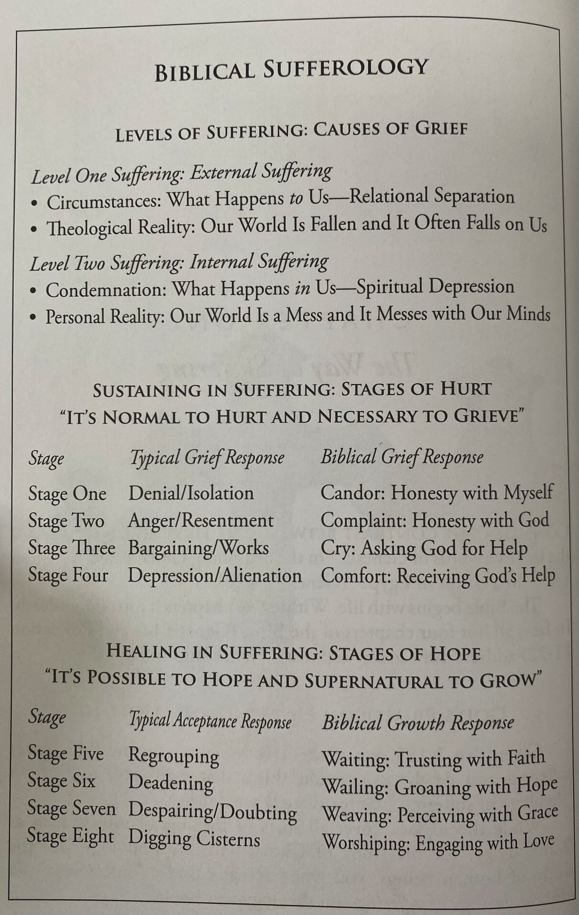

Slide 6
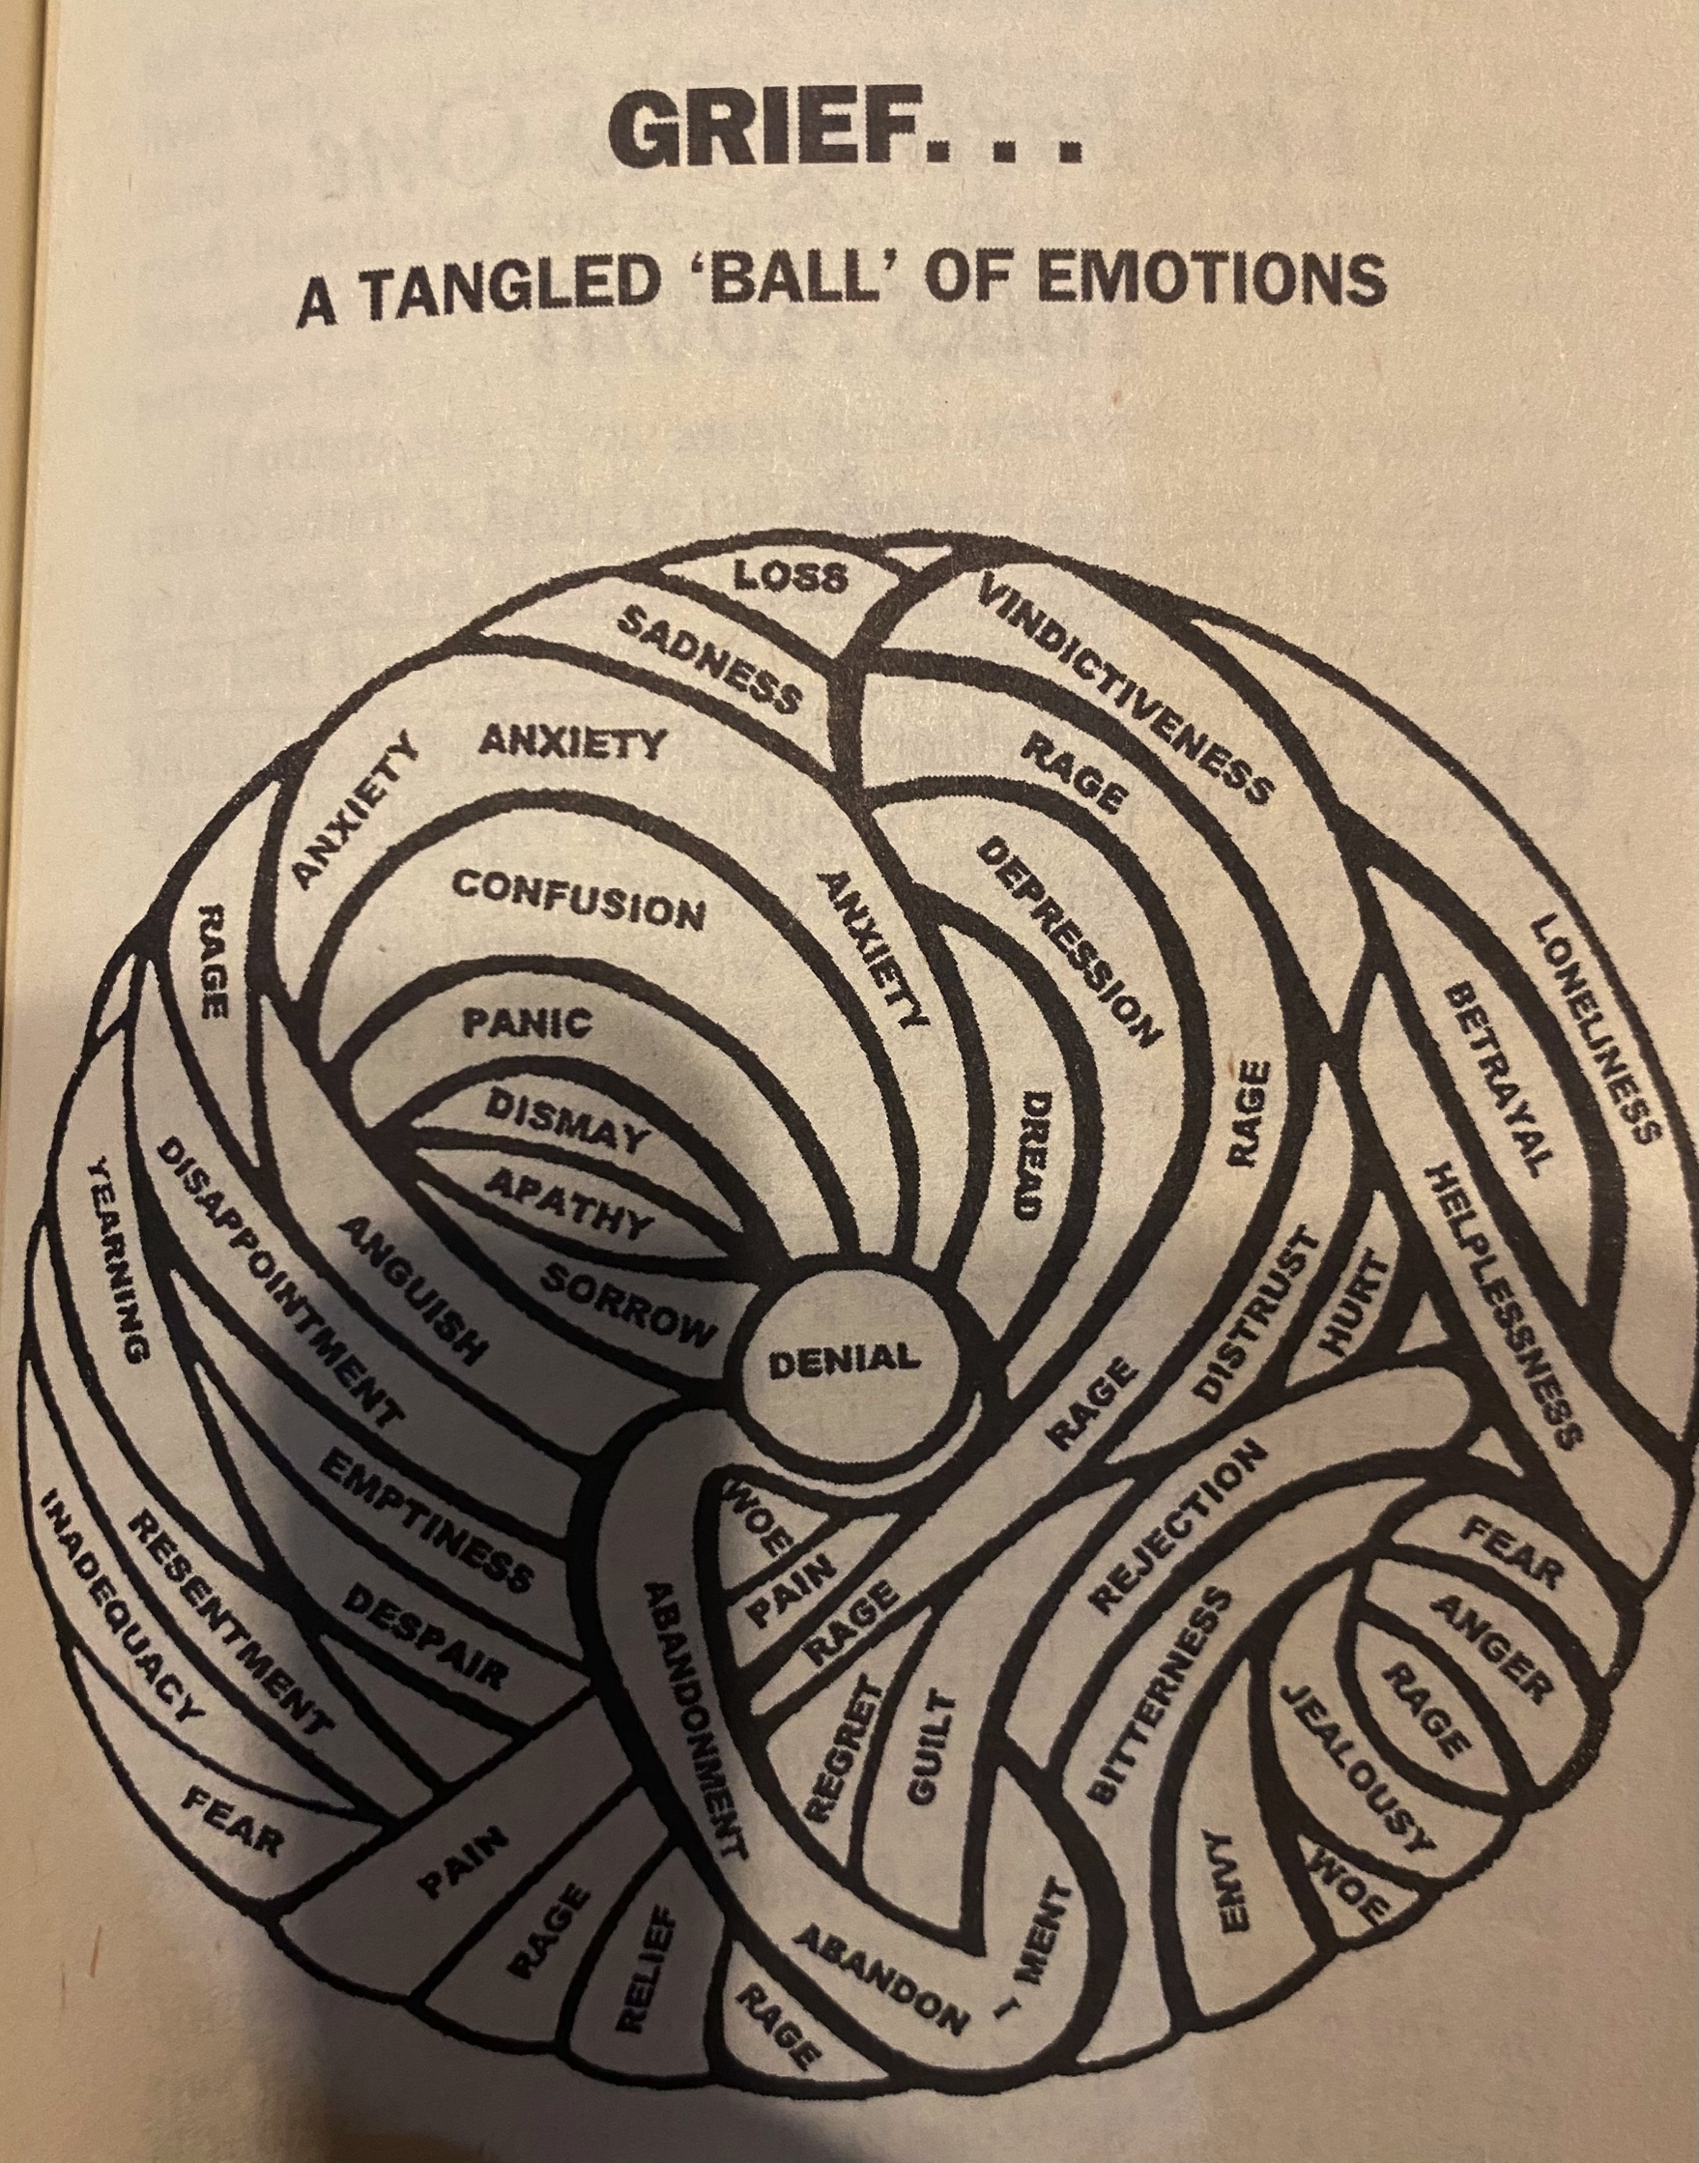

Slide 7
Village Candor: Honesty with myself.
Homework:
Looking to the story of Job, who tore his robe, shaved his head, and fell in worship, we can reflect on his external losses and internal struggles. What did he lose on the outside? What internal challenges did he face? What did God say about his response in 1:22?
What did I lose? What is missing? What has changed as a result? What has changed about my identity?
How do I feel? How has that affected me – emotionally, physically, relationally, spiritually?
Then Job arose and tore his robe and shaved his head and fell on the ground and worshiped. And he said, “Naked I came from my mother's womb, and naked shall I return. The Lord gave, and the Lord has taken away; blessed be the name of the Lord.” In all this Job did not sin or charge God with wrong. Job 1:20-22

Slide 8
Village Complaint: Honesty with God
“And he took a piece of broken pottery with which to scrape himself while he sat in the ashes. Then his wife said to him, "Do you still hold fast your integrity? Curse God and die." But he said to her, "You speak as one of the foolish women would speak. Shall we receive good from God, and shall we not receive evil?" In all this Job did not sin with his lips.” Job2.8-10
Homework:
Where have you judged God in your grief? What was your expectation of him? Have you humbly confessed this to him ?
Were it not for the grace of God and his mercy what would your life be like?
Read Lamentations 3:1-33 and identify the 4 aspects of lament. (Do this after Marks session on Friday afternoon.)
Write your own lament.

Slide 9
Village Cry: Ask for God’s Help
Trust in him at all times, O people; pour out your heart before him; God is a refuge for us. Selah “ Ps62.8
Homework:
Can you trust God with all you have and say, it is all of yours to do with as you will?
How do you admit you to God that you desperately need him. That you can not survive without him.
Reflect on 2 Corinthians 1:8-10. What is the purpose of Paul’s suffering? Where are you in this process?
How is your mindset works-based when it comes to your grief?
Pray on your face with your hand lifted up to God.
“Suffering is God’s primary way of uprooting our self reliance and complacency.” Kellemen, Bob. Gods Lessons for Life’s Losses

Slide 10
Village Comfort: Receiving God’s Help
“Shared sorrow is endurable sorrow.” Kellerman, Bob. Gods Lessons for Life’s Losses.
For we do not have a high priest who is unable to sympathize with our weaknesses, but one who in every respect has been tempted as we are, yet without sin. Let us then with confidence draw near to the throne of grace, that we may receive mercy and find grace to help in time of need. Heb4.15-16
Homework:
How are you facing the temptation to give up on God or to isolate in your pain?
How is the Body of Christ encouraging and coming alongside you in this season?
Are you refusing comfort from the Lord or the body of believers and how is this aggravating your pain?
Thank God for a specific instance of his comfort in your loss this week.

Slide 11
Village Waiting: Trusting with Faith
“Waiting is refusing to take over while refusing to give up.” Kellemen, Bob. God’s Lessons for Life’s Losses.
Homework:
Where are you tempted to jump ahead? How are you choosing to trust God’s provision without taking matters into your own hands?
What have you experienced as you have chosen to wait on God?
Are you resting in his perfect timing and provision knowing he doesn’t provide quick answers? Are you demanding answers still or are you able to rest in the truth that “The secret things belong to the Lord” Deuteronomy 29:29
Are you able to surrender your demand to feel better right away, your dependence, your expectations, plans, and dreams?

Slide 12
Village Wailing: Groaning with Hope
Proverbs 13:12 says, "Hope deferred makes the heart sick, but a hope fulfilled is the tree of life."
Homework:
What do you know about Heaven and eternity? How often did you think about it before your loss? How often do you think of it now?
How have you been tempted to find your identity in your sorrow?
Since your loss, what is your new normal?
What has grief taught you?

Slide 13
Village Weaving: Perceiving with Grace
“What you believe about the future will change how you live in the present.” Nyeri, Daniel. Everything Sad is Untrue.
Homework:
Consider the story of Joseph – What good was God up to amidst so much evil?
Looking at your suffering where do you doubt that there can be blessing? Where do you see sorrow and joy together in your loss?
What was your definition of good prior to the loss of your loved one? Has it changed? What is a gospel centered definition of good?

Slide 14
Village Worshiping: Engaging with Love
“Indeed, I count everything as loss because of the surpassing worth of knowing Christ Jesus my Lord. For his sake I have suffered the loss of all things and count them as rubbish, in order that I may gain Christ and be found in him, not having a righteousness of my own that comes from the law, but that which comes through faith in Christ, the righteousness from God that depends on faith-“ Phil3.8-9
Homework:
What cisterns have you dug and drank from in your grief?
When has intimacy with God been seen as a consolation prize in your suffering?
Do you want more of God in your loss or would you want relief more?

Slide 15


